Slide 1
Database Management Systems I Databases and Database Management Systems
Lecturer: Akanferi Albert akanferi@yahoo.com

Slide 2
Essential Areas of Part 1
Problems with File-based System
Advantages Offered by Database Approach
Database Environment
Advantages of Three-level ANSI-SPARC Architecture
Popular Data Models

Slide 3
History of Databases
Databases have been a staple of business computing from the very beginning of the digital era.
Relational database was born in 1970 when E.F. Codd, a researcher at IBM, wrote a paper outlining the process.
Since then, relational databases have grown in popularity to become the standard.

Slide 4
The Flat File System
Originally, databases were flat.
This means that the information was stored in one long text file, called a tab delimited file.
Each entry in the tab delimited file is separated by a special character, such as a vertical bar (|).
Each entry contains multiple pieces of information (fields) about a particular object or person grouped together as a record.

Slide 5
The Flat File System
The text file makes it difficult to search for specific information or to create reports that include only certain fields from each record. Here's an example of the file created by a flat database:
Lname, FName, Age, Salary|Smith, John, 35, $280|Doe, Jane, 28, $325|Brown, Scott, 41, $265|Howard, Shemp, 48, $359|Taylor, Tom, 22, $250

Slide 6
Filed-Based System Defined
A collection of application programs that perform services for the end-users such as the production of reports.
Each program:
- defines and
- manages
its own data.

Slide 7
Filed-Based Systems
File-based processing
Back to 11

Slide 8
Features of the File-Based Systems
Earlier attempt at computerising manual filing system
Can be efficient if data is small
Unable to handle cross-reference of process information in files
Decentralised
Unable to handle concurrent usage

Slide 9
Limitations of the File-Based Approach
Separation and isolation of data
Duplication of data
Data dependence
Incompatible file formats
Fixed queries/proliferation of application programs
No provision for security or integrity
Limited or non-existent recovery
Single user at a time

Slide 10
Database Defined
A shared collection of logically related data, and a description of this data, designed to meet the information needs of an organisation.
A very large, integrated collection of data.
Models real-world situations
- Entities (e.g., students, courses)
- Relationships (e.g., Kelly is taking SICS 325)

Slide 11
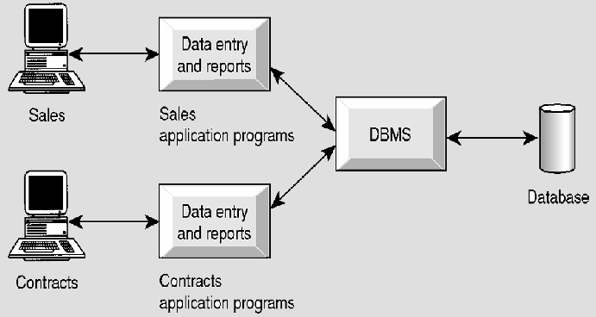
Database systems
Database processing
Back to 21

Slide 12
Some uses of Databases
Using the internet
Studying at a the university
Taking out insurance
Using the library
Booking a flight or room reservation
Purchases from a supermarket
Purchases using a credit card

Slide 13
File-based Approach Vs Database Approach
Decentralised database | Shared database
Program-data dependence | Program-data independence
Direct Data Access | Data abstraction
One user at a time | Concurrent users
Unrelated data | Logically related data
Holds only organisation operational data | Holds a description of the data:-system catalog/ data dictionary/metadata
Data duplication | Minimum data duplication
Notes:
CAD is simply the process of implementing software

Slide 14
What Is a DBMS?
A Database Management System (DBMS) is a
software package designed to store and manage databases.
information:
The DBMS is the software that interacts with the users’ application programs and the database

Slide 15
What is an (Database) Application program?
Definition:
Refers to a computer program that interacts with the database by issuing an appropriate request to the DBMS.
Notes:
Business Process Reengineering

Slide 16
Why Use a DBMS?
Data independence and efficient access.
Reduced application development time.
Data integrity and security.
Uniform data administration.
Concurrent access, recovery from crashes.

Slide 17
Why Study Databases??
Shift from computation to information
at the “low end”: scramble to webspace (a mess!)
at the “high end”: scientific applications
Datasets increasing in diversity and volume.
Digital libraries, interactive video
... need for DBMS exploding
DBMS encompasses most of CS
OS, languages, theory, multimedia, logic

Slide 18
Facilities provided by DBMS
Allows user definition of the database
Data Definition Language (DDL)
Allows user manipulation – insert, update, delete, retrieve
Data Manipulation Language (DML)

Slide 19
DBMS facilities (Cont.)
Controlled access to database
Security system
Integrity system
Concurrency system
Recovery control system
User-accessible catalog (Data Dictionary)
Views (which provides)
Level of security
Customised appearance of database
Presents consistent structure of database

Slide 20
Components of the DBMS Environment
Data
Hardware
Software
Procedures
People
Bridge
Machine
Human

Slide 21
Most Popular Relational DBMS
Microsoft Access
Filemaker
Microsoft SQL Server
MySQL
mSQL,
others
Oracle
DB2,
Ingress,
Postgress,
PostgresSQL,

Slide 22
Roles in the Database Environment
(People involved in the database environment)
Data Administrator (DA)
Responsible for the management of the data resource
Planning, development, and maintenance of policies, standards and procedures and conceptual and logical design
Database Administrator (DBA)
Responsible for physical realisation of database
design and implementation, security and integrity control, maintenance of system
Role more technical, requiring detail knowledge

Slide 23
Roles in the Database Environment (cont)
Application Developers
Responsible for the provision of the required functionality for the end-user
End-User
Naïve user – Knows very little about the DBMS and access database through simple application programs
Sophisticated user – Familiar with the structure of the database and facilities offered by the DBMS and able to maximise use by using queries or simple self-written application programs

Slide 24
Advantages and Disadvantages of DBMSs
Advantages | Disadvantages
Control of data redundancy | Complexity
Data consistency | Size
More information from the same amount of data | Cost of DBMS
Shared data | Additional hardware cost
Improved data integrity | Cost of conversion
Improved security | Performance
Enforcement of standards | Higher impact of failure
Economy of scale

Slide 25
Database Structures
Common database structures…
Hierarchical
Network
Relational
Object-oriented
Multi-dimensional

Slide 26
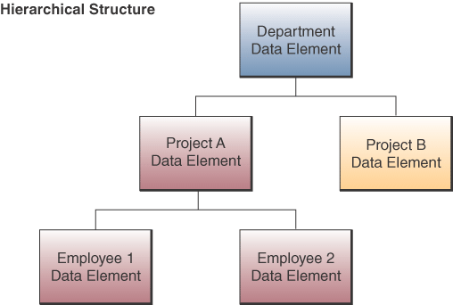
Hierarchical Structure
Early DBMS structure
Records arranged in tree-like structure
Relationships are one-to-many

Slide 27
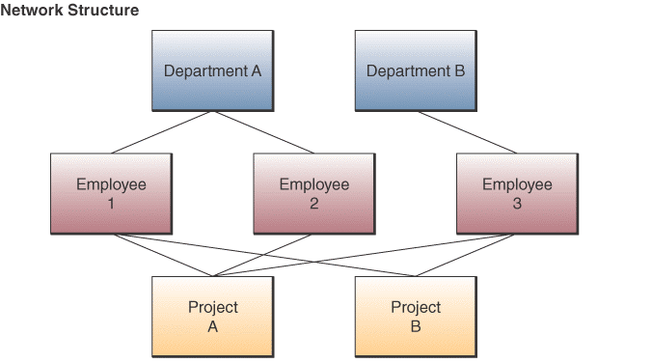
Network Structure
Used in some mainframe DBMS packages
Many-to-many relationships

Slide 28
Relational Structure
Most widely used structure
Data elements are stored in tables
Row represents a record; column is a field
Can relate data in one file with data in another, if both files share a common data element

Slide 29
Relational Operations
Select
Create a subset of records that meet a stated criterion
Example: employees earning more than $30,000
Join
Combine two or more tables temporarily
Looks like one big table
Project
Create a subset of columns in a table

Slide 30
Multidimensional Structure
Variation of relational model
Uses multidimensional structures to organize data
Data elements are viewed as being in cubes
Popular for analytical databases that support Online Analytical Processing (OLAP)

Slide 31
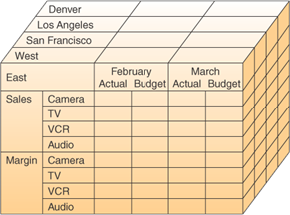
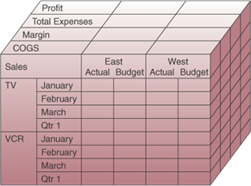
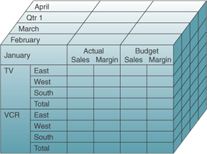
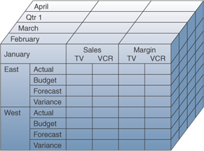
Multidimensional Model

Slide 32
Object-Oriented Structure
An object consists of
Data values describing the attributes of an entity
Operations that can be performed on the data
Encapsulation
Combine data and operations
Inheritance
New objects can be created by replicating some or all of the characteristics of parent objects

Slide 33
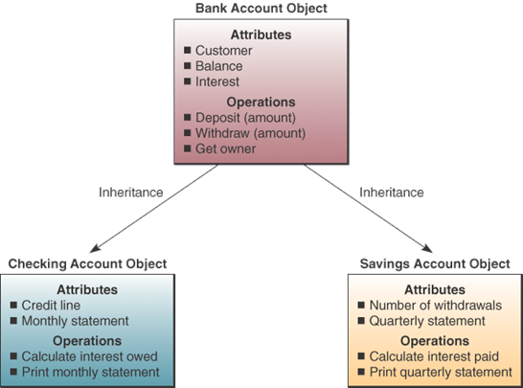
Object-Oriented Structure
Source: Adapted from Ivar Jacobsen, Maria Ericsson, and Ageneta Jacobsen, The Object Advantage: Business Process
Reengineering with Object Technology (New York: ACM Press, 1995), p. 65.
Copyright @ 1995, Association for Computing Machinery. By permission.

Slide 34
Object-Oriented Structure
Used in object-oriented database management systems (OODBMS)
Supports complex data types more efficiently than relational databases
Examples: graphic images, video clips, web pages

Slide 35
Evaluation of Database Structures
Hierarchical
Works for structured, routine transactions
Can’t handle many-to-many relationship
Network
More flexible than hierarchical
Unable to handle ad hoc requests
Relational
Easily responds to ad hoc requests
Easier to work with and maintain
Not as efficient/quick as hierarchical or network

