Slide 1
THANKS BE TO GOD ALMIGHTY

Slide 2
Introduction to Computer Technology
Session_1
Information Concepts
Akanferi Albert
akanferi@yahoo.com
akanferi@gmail.com
026-7023-177

Slide 3
OBJECTIVES OF THE SESSION
Define and describe Information Concepts
Explain how data is processed into information
Explain Information Systems Literacy
Explain Computer-Based Information Systems (CBIS) & its Components/Elements
Identify the qualities of good Information
Explain the value of Information
Identify Information Systems Types – The Levels of Information

Slide 4
INFORMATION CONCEPTS
Information concepts involves several terms and phrases which we need to understand and appreciate before we can continue:
Data processing
Data
Information
Information Systems Literacy
Computer Literacy
Information Technology
Information System
A Computer Based Information System (CBIS)

Slide 5
DATA PROCESSING
General: Operations performed on a given set of data to extract the required information in an appropriate form such as
diagrams,
reports, or
tables.
Computing: Manipulation of input data with an application program to obtain desired output as an audio/video, graphic, numeric, or text data file.
Notes:
Computer data processing is any process that uses a computer program to enter data and summarise, analyse or otherwise convert data into usable information. It involves recording, analysing, sorting, summarising, calculating, disseminating and storing data. Because data are most useful when well-presented and actually informative, data-processing systems are often referred to as information systems.

Slide 6
DATA
Raw facts of events that took place internally (daily activities of the organization) and externally (competitors and social activities).
Data consist of figures, numbers, letters and transactions which have been recorded but not yet processed into a form suitable for decision making.
Data is meaningless unless it is processed into information.
IS transforms raw data into useful in formation.
Data can be processed by classifying, sorting, interpreting, calculating, summarizing, destroying etc.
Data and information are relative to the user.
What one may classify as information another may see it to be data.

Slide 7
INFORMATION
Information is data that have been processed or transformed into meaningful and useful form for decision-making.
Information is therefore organized facts that have value beyond the value of the data or facts.
It is data that has meaning within a specific context and can be obtained through input (raw data), processing and output (information)
Notes:
The terms data and information are often used interchangeably, however, it is better to view data as raw material resources that are processed into finished information products. Then information can be defined as data that have been converted into a meaningful and useful context for specific end users.

Slide 8
DATA + MEANING = INFORMATION
STORE
Protect
DATA
INFORMATION
INPUT
Originate data
PROCESS
Sort
Calculate
Compare
Summarize
retrieve
OUTPUT
Report
Display
MEANING

Slide 9
INFORMATION SYSTEMS LITERACY
Deals with having Broad-based understanding of IS which includes behavioral knowledge about organizations and individuals using information systems.
It basically deals with having in-depth knowledge in how to gather and process the appropriate data into information .

Slide 10
COMPUTER LITERACY
It deals with having knowledge about information technology, focusing on understanding how computer-based technologies work.
It involves having knowledge in computer hardware and software which are collectively used to process data into information.

Slide 11
INFORMATION TECHNOLOGY (IT)
This is a contemporary term that describes the combination of computer hardware, software & communication networks in a computer based environment.
IT involves any equipment used in
capturing,
storage,
transmission or communication of data.
The various IT equipment work towards a common goal.

Slide 12
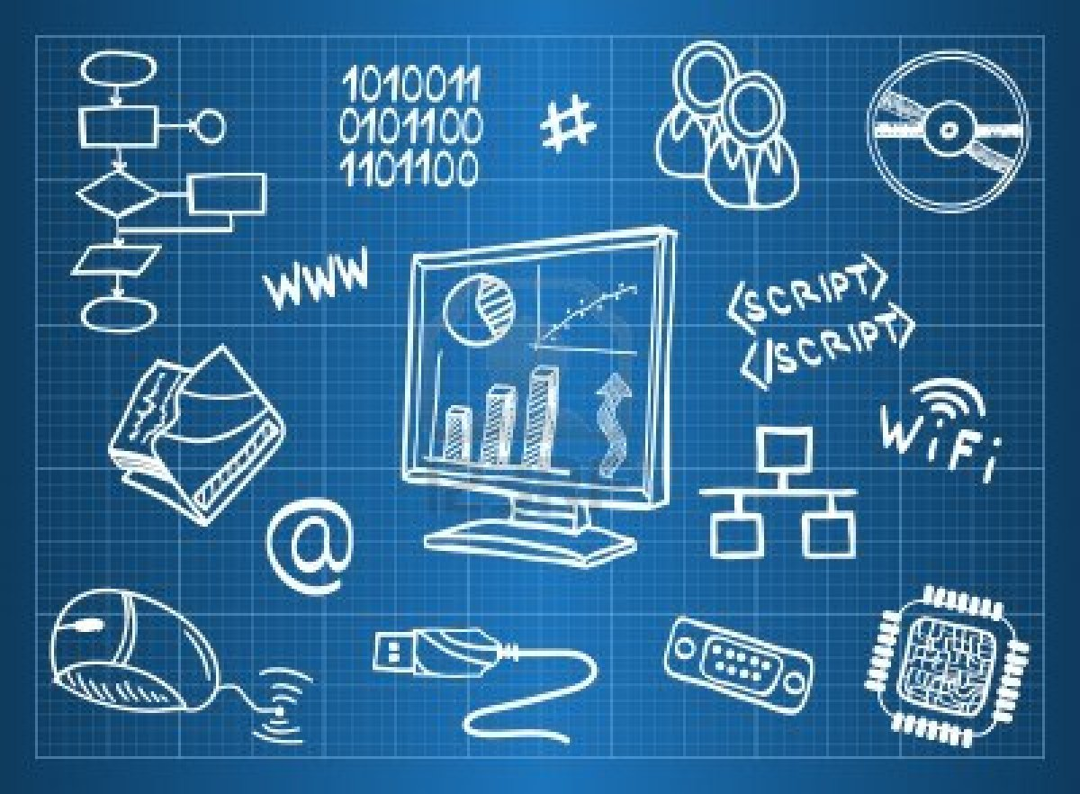

Slide 13
INFORMATION SYSTEM (IS)
Deals with the provision and management of information to support the operations of the organization.
Examples are MIS, DSS, TPS etc.
An IS involves six interdependent elements:
Hardware (pen, pencils, sheets),
software (instructions),
People (managers, workers etc),
procedures (rules),
data and network (information).
All six elements interact to convert data into information.

Slide 14
A COMPUTER BASED INFORMATION SYSTEM (CBIS)
People Resources
Hardware Resources
Software Resources
Data Resources
Network Resources
Procedures
An organized combination of people, hardware, software, common networks, and data resources that collects, transforms and disseminate information in an organization.
A CBIS involves six interdependent elements:
All six elements interact to convert data into information

Slide 15
A COMPUTER BASED INFORMATION SYSTEM (CBIS)
Helps businesses improve the efficiency and effectiveness of their
business processes,
managerial decision-making and
workgroup collaboration
thus strengthen their competitive positions in a rapidly changing market place.

Slide 16
Information Systems Resources and Products
People Resources Specialists-systems analysts, software developers, system operators. End users-anyone else who uses information systems.
Hardware Resources Machines-computers, video monitors, magnetic disk drives, printers, optical scanners. Media-floppy disks, magnetic tape, optical disks, plastic cards, paper forms.
Notes:
People are required for the operation of all Information System. These people resources include end users (also called users or clients) are people who use Information System or the information it produces.

Slide 17
Information Systems Resources and Products
Software Resources Programs-operating systems programs, spreadsheet programs, word processing programs, payroll programs.
Data Resources Product descriptions, customer records, employee files, inventory database.
Notes:
The concept of software resources includes all sets of information processing instruction. This generic concept of software includes not only the sets of operating instructions called programming, which direct and control computer hardware, but also the sets of information processing instructions called procedures that people need.
2. Data can take many forms, including traditional alphanumeric data, composed of numbers and alphabetical and other characters that describe business transactions and other events and entities.

Slide 18
Information Systems Resources and Products
Network Resources Communication media, communications processors, network access and control software.
Procedures Resources Rules that govern data entry procedures, error correction procedures, paycheck distribution procedures.
Notes:
1. Network Resources: Telecommunications technologies and networks like the Internet, intranets and extranets have become essential to the successful electronic business and commerce operations of all types of organizations and their computer-based information system. Telecommunications consists of computers, communications processors and other devices interconnected by communications media and controlled by common software.

Slide 19
QUALITIES OF GOOD INFORMATION
Information is a resource that can be used to gain
competitive advantage,
effective and efficient management.
Good information has value to the users and the basic qualities or attributes are:

Slide 20
QUALITIES OF GOOD INFORMATION
Accuracy: error free
Complete: contains all important facts
Timeliness: available at the time it is needed
Reliable: can be depended upon
Relevant: aid decision-making
Economical/cost effective: production cost of information should not exceed its benefits

Slide 21
QUALITIES OF GOOD INFORMATION
Simple: Not over loaded
Understandable:
Communicate to the right person:
Communicated through the right channel:
Verifiable: possible to cross check

Slide 22
QUALITIES OF GOOD INFORMATION
People want information of high quality, i.e, information whose characteristics, attributes or qualities help to make the information more valuable to them.
It is useful to think of information as having the three dimensions:
Dimensions of time,
Content and
Form.

Slide 23
TIME DIMENSION
Timeliness: - Information must be produced when needed.
Currency: - Must be up-to-date.
Frequency: - Should be provided as often as needed.
Time period: - Can be provided about past, present and future time periods.

Slide 24
CONTENT DIMENSION
Accuracy - Should be free from errors.
Relevance - Should be related to the information needs of a specific recipient for a specific situation.
Completeness - All information needed should be provided.
Conciseness - Only the information that is needed should be provided.
Scope – Can have a broad or narrow scope or an internal or external form.
Performance – Can reveal performance by measuring activities accomplished, progress made or resource accumulated.

Slide 25
FORM DIMENSION
Clarity – Should be produced in a form that is easy to understand.
Detail - Can be provided in detail or summary form.
Order – Can be arranged in a pre-determined sequence.
Presentation – Can be presented in narrative, numeric, graphic or other forms.
Media – Can be provided in the form of printed papers document, video displays or other media.

Slide 26
VALUE OF INFORMATION
Value of information is related to how it helps decision makers achieve the organizational goals and objectives.
It measures the outcome of the application of given information in decision making.

Slide 27
INFORMATION SYSTEM TYPES
Levels of information
Information can be classified generally to be at
international,
national,
corporate,
departmental and
individual levels.

Slide 28
INFORMATION SYSTEM TYPES
Levels of information
In terms of an organization, information can be classified in relation to the organizational structure or management
operational/low,
tactical/middle or
strategic/top levels

Slide 29
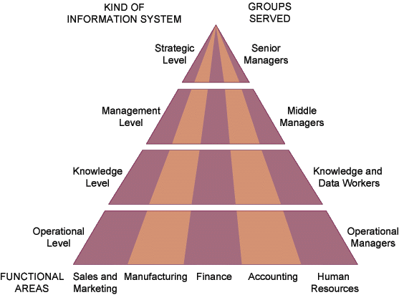

Slide 30
LOWER OR OPERATIONAL LEVEL
Operational-level-system supports operational managers by keeping track of the elementary activities and transactions in the organization.
Make structured decision.
Transaction Processing System (TPS)
Office Automation System (OAS)
Knowledge work system (KWS)
Notes:
TPS processes large data for routine business transaction. It is the heart of most business organizations and its activities include routine day-to-day transaction and focuses on efficiency.
It enables the organization to interact with external environment. Eg account payable, account receivable, purchasing, payroll, general ledger, airline
reservation and ATM.
2. OAS supports data workers who do usually create new knowledge.
3. These are professional workers (scientist, engineers, doctors) Eg spreadsheet, word processing etc.

Slide 31
MIDDLE OR TACTICAL LEVEL
Carry out the programs and plans of senior management. Make semi
Used for structured decision
Management information system (MIS)
Decision Support System(DSS)
Expert system & Artificial Intelligent (ES or AI)
Notes:
1. MIS provides management with an in-depth knowledge about the organization. The outputs of TPS/OAS/KWSS serve as input to MIS. The outputs of MIS are management reports (Scheduled, Key indicators, demand, exception, and predictive reports). It focuses on less structured decision-making. Eg inventory control, budget or cost analysis, capital or price analysis and sales management analysis.
2. It is similar to MIS which depends on the output from the operational level. It emphasizes the support of decision making in all phases. It performs sophisticated analysis leaving the judgement to the decision maker.
3. ES captures and uses the knowledge of expert for solving problems. ES selects the best solution to the problem.

Slide 32
STRATEGIC OR TOP LEVEL
Make long-range strategic decisions about products and services. Make unstructured decision.
Executive Support Systems (ESS)
Group Decision Support System (GDSS)
Computer support collaborative work system (CSCWS).
Notes:
1. ESS helps executive organize their interaction with the external environment by providing graphs, communication support in accessible places. It solves unstructured decision with high degree of uncertainty which is future oriented. Eg 5years sales, 5years operation plan, 5years budget, 5years profit level and 5years personnel plan.
2. GDSS permits group members to interact with electronic support to make semi structured or structured decision. It is intended to bring the group together to solve a problem and its minimizes negative group behaviour (fear)
3. It is similar to GDSS but it includes a “groupware” for team collaborative via networked computers.

Slide 33
INFORMATION PYRAMID
Type of Decision
Type of Information Systems
Executive Support Systems (ESS)
Unstructured
Support
Strategies for
Competitive Advantage
Decision Support Systems (DSS)
Management Information Systems (MIS)
Semi-structured
Support
Business Decision Making
Transaction Processing Systems (TPS)
Structured
Support
Business Processes and Operations
Notes:
ESS is used to make decisions my senior managers.
ESS serves the strategic level of the firm.
ESS addresses unstructured decisions.
It is not designed to solve specific problems.
Instead, it is designed to provide a generalized computing and communication capacity that can be applied to a changing array of problems.
Designed to be less analytical.
2. DSS serves the management level of the organization.
DSS help managers make decisions that are semi-structured, unique, or rapidly changing and not easily specified in advance.
Designed to be highly analytical.
MIS also serves the management level of the organization providing managers with reports and in some case current and historical records.
MIS primarily serves the functions of planning, controlling and decision making at the managerial level.
These systems are dependent on the underlying TPS for their data.
MIS summarizes and reports on the basic operations of the company.
3. TPS processes large data for routine business transaction.
It is the heart of most business organizations and its activities include routine day-to-day transaction and focuses on efficiency.
It enables the organization to interact with external environment. Eg account payable, account receivable, purchasing, payroll, general ledger, airline reservation and ATM.
Office Automation System (OAS) workers are less formal qualifications and tend to process rather than create information.
Typically they handle word processing, publishing etc jobs.

