Slide 1
INTRODUCTION TO INFORMATION TECHNOLOGY
Session_2
Systems Theory & Concepts
ALBERT AKANFERI

Slide 2
Objectives
Understand the general systems theory
Explain the various approaches to systems theory
Appreciate the importance of systems theory in problem solving
The steps in problems solving

Slide 3
Objectives
Define and explain a system
Identify and explain the components of a physical system
Understand the importance of feedback and control in a system
Explain the various classifications of systems

Slide 4
Introduction to System Theory
General Systems Theory
System Theory
System theory is a way of modeling and managing a system or organization’s activities.
A system is a dynamic complex entity with so many components that should be well managed.
The various approaches to system theory are:

Slide 5
Approaches To System Theory
Holistic or Synergy approach
Reductionist or Sub-optimality approach
Optimization approach
Murphy approach
Notes:
1. It states that the whole of a system is greater than the sum of its parts.
Mathematically it implies that 2>1+1
2. It states that much attention should be giving to parts (important components) but not the whole of the system due to resources constraints.
ace
3. It states that it is easier to get a working system efficient than an efficient system working.
4. It states that if anything will go wrong then it will one day go wrong irrespective of the precautionary measures put in place

Slide 6
Essence of Systems Approach to Problem Solving
The scientific approach to problem solving consists of the following steps:
Recognize phenomena in the real world
Formulate a hypothesis about the causes or effects of the phenomena
Test the hypothesis through experiment
Evaluate the results of the experiment
Draw conclusions about the hypothesis

Slide 7
System approach to problem solving is a modification of the scientific method
Define a problem
Evaluate Solution
Gather Data
Implement Selected Solution
Design Alternative Solution
Evaluate Alternative
Select Best Solution
Notes:
Define a problem or an opportunity in a system concept
Gather data describing the problem or opportunity
Identify alternative solution
Evaluate each alternative solution
Select the best solution
Implement the selected solution
Evaluate the success of the implemented solution

Slide 8
Introduction to System Concepts.
I. General Systems Theory
System Concept
Def. A System is a set of components or process that interact with one another to achieve a specific objective or serve a common purpose or goal.
Systems may by (1) abstract or (2) physical.
• An abstract system is conceptual, a product of a human mind. That is, it cannot be seen or pointed to as an existing entity. Social, theological, cultural systems are abstract systems. None of them can be photographed, drawn or otherwise physically pictured. However, they do exist and can be discussed, studied and analyzed.

Slide 9
A physical system, in contrast, has a material nature. It is based on material basis rather than on ideas or theoretical notions.
System has nine main characteristics:
Components. 6. Input.
Interrelationships. 7. Output.
Boundary. 8. Interface.
Purpose. 9. Constraints.
Environment.
They are shown in Figure 1-1.

Slide 10
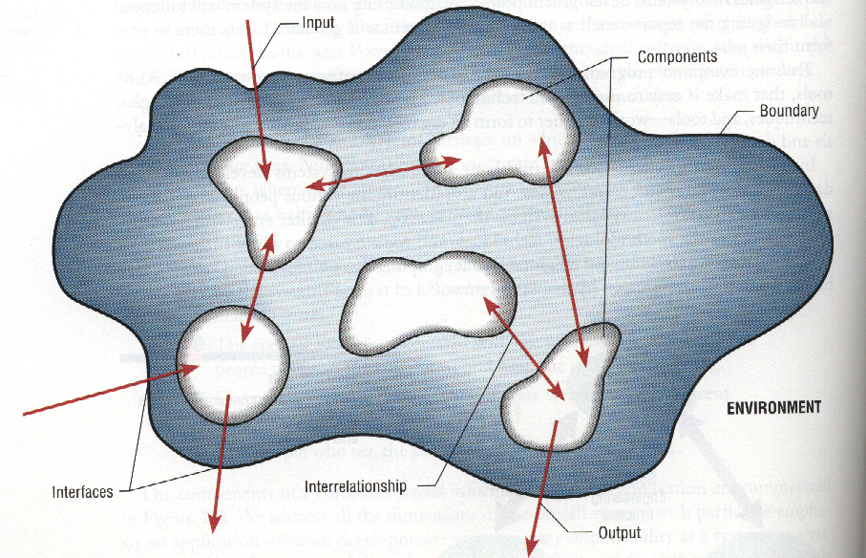
FIGURE 1-1 Characteristics of a system

Slide 11
2. System’s Characteristics
• A component is either an irreducible part or an aggregate of parts, also called a subsystem. The simple concept of a component is very powerful. For example, in case of an automobile we can repair or upgrade the system by changing individual components without having to make changes the entire system.
• The components are interrelated; that is, the function of one is somehow tied to the function of the others. For example, in the Store system the work of one component, such as producing a daily report of customer orders, may not progress successfully until the work of another component is finished, such as sorting customer orders by date of receipt.

Slide 12
• A system has a boundary, within which all of its components are contained and which establishes the limits of a system, separating it from other systems.
• All of the components work together to achieve some overall purpose: the system’s reason for existing.
• A system operates within an environment – everything outside the system’s boundary. The environment surrounds the system, both affecting it and being affected by it. For example, the environment of a university includes prospective students, foundations, funding agencies and the new media. Usually the system interacts with its environment. A university interacts with prospective students by having open houses and recruiting from local high schools.

Slide 13
2. System’s Characteristics
• The point at which the system meets its environment are called interface.
• A system must face constraints in its functioning because there are limits to what it can do and how it can achieve its purpose within its environment. Some of these constraints are imposed inside the system (e.g., a limited number of staff available).
Others are imposed by the environment (e.g., due to regulations).

Slide 14
• A system interact with the environment by means of input and output. Input is anything entering the system from the environment; output is anything leaving the system crossing the boundary to the environment . Information, energy, and material can be both input and output in relation to the environment.
People, for example, take in food, oxygen, and water from the environment as input.
An electrical utility takes on input from the environment in the form of raw materials (coal, oil, water power, etc), requests for electricity from customers. It provides for output to the environment in the form of electricity.

Slide 15
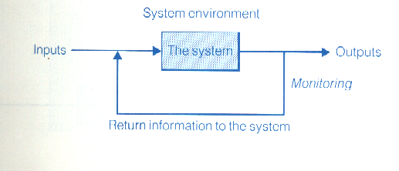
3. Feedback and Control in a System
Very often output’s data are returned to the input of the system, as shown in Fig. 2, and used to regulate the system’s activity. Large hotels and motels, for instance, ask guests to fill out cards evaluating the services. Such a process is called feedback. It helps to adjust the system to changes so that the system operates in a balanced state, or equilibrium. This feature of a system is used in control.
FIGURE 2 Regulation of activity

Slide 16
Def. Control is the process that measures current performance and guides it toward a predetermined goal.
Two types of feedback are related to system control.
• Negative feedback is corrective feedback that helps maintain the system within a critical operating range and reduces performance fluctuations around the norm or standard. Negative feedback is transmitted in feedback control loops. As shown in Figure 1-3, a sensor detects the effect of output on the external environment; this information is returned to the system as an input, and necessary adjustments are made according to predetermined goal.

Slide 17
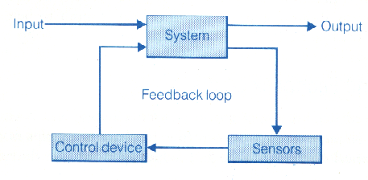
• In contrast to negative feedback, which is corrective, positive feedback reinforces the operation of a system by causing it to continue its performance and activities without changes.
FIGURE 3 Feedback control loops

Slide 18
System classifications
Deterministic system
Probabilistic system
Cybernetic/Adaptive/Self organizing system
Real time system
Batch system
On-line system
Off line system
Open system
Close system
Notes:
1. The output of the system can be determined/predicted base on the input (payroll)
2. The output of the system can be predicted from the previous state and there is always a certain degree of error. (lotto)
3. These are systems that learn from their mistakes, react and adapt to a particular input
4. The operational activities of the system require immediate or rapid response (ATM)
5. Accumulates transaction or records of events over period of time before processing
6. A system in which input, process and output are done under the control of the computer network system
7. It is a manual system with no electronic or computer interconnection
8. Open system accepts inputs from external environment
9. A system that does not interact with the external environment

Slide 19
Systems Concepts
b. Deterministic versus probabilistic
  deterministic: The interaction between the parts or subsystems is known for certain;
    example: a computer program which performs exactly to a set of instructions
  probabilistic: A system that can be described in terms of probable behavior (a certain degree of error);
    examples: An inventory system, a five year old (who does not follow a certain set of instructions).

Slide 20
Systems Concepts
c. Closed and open systems:
  Closed system: self contained, one that does not exchange material, information, or energy with its environment.
  Examples:
    Solar system,
    Locked Storage Vault
    A chemical reaction in a sealed, insulated container.

Slide 21
System Types
Deterministic Systems | Probabilistic Systems
operates in predictable manner interaction is known with certainty eg.: computer program | probable behavior certain degree of error eg.: inventory system
Closed Systems | Open Systems
self-contained no exchange with environment eg.: sealed chemical reaction | self-organizing exchange with environment eg: living systems, organizations

Slide 22
Systems Concepts
  Relatively closed systems: in organizations and in information processing, there are systems that are relatively isolated from the environment, but are not completely closed, these will be considered closed systems.
  Examples:
    manufacturing system
    a computer program with well defined inputs, a process and an output (No agents)

Slide 23
Systems Concepts
    Open Systems: exchange information, material, or energy with the environment, including random and undefined inputs.
    Examples:
      Biological Systems, and Organizational Systems
    Open systems tend to have form and structure
    Adapt to changes in environment so as to continue to exist
      Figure 10.3

Slide 24
Closed Systems
No exchanges with
environment
Relatively Closed System
Controlled exchange with environment insulated from outside disturbances
Known and defined output
Known and defined input
Open System
Known
Known
Unknown
Disturbances
Subject to known and unknown inputs and environmental disturbances
Output

Slide 25
5. “Systems” Thinking
Being able to identify something as a system
Involves being able to identify subsystems
Identifying system characteristics and functions
Identifying where the boundaries are (or should be)
Identifying inputs and outputs to systems
Identifying relationships among subsystems

